Slide 1

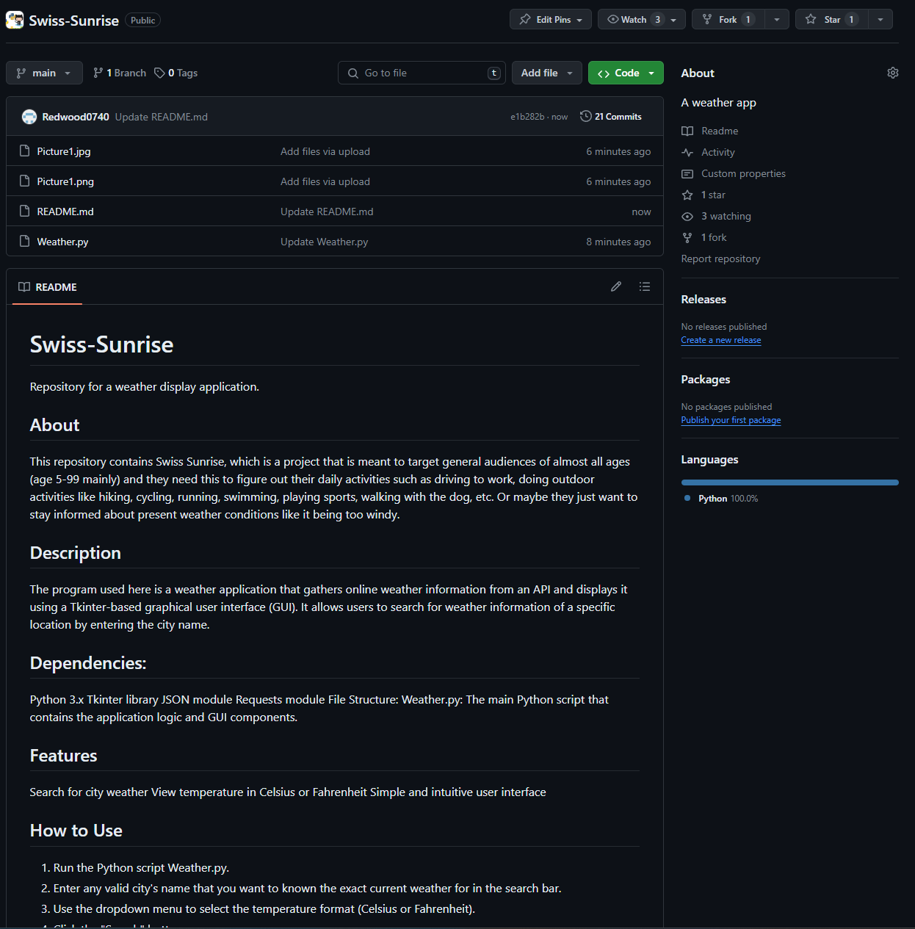
Swiss Sunrise
"Sunrise to Sunset, Swiss Style."
By Daniel Mellon and Jett Perry

